Slide 1
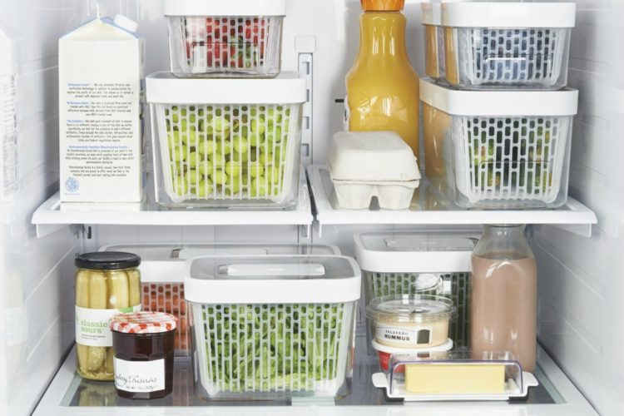
FOOD CONTAINERS

Slide 2
a can

Slide 3
a tin

Slide 4
a bag

Slide 5
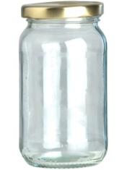
a jar

Slide 6
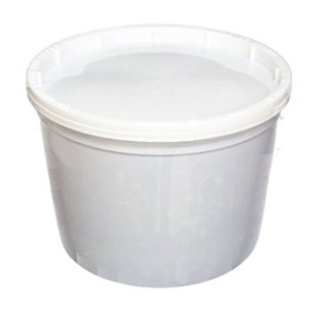
a tub

Slide 7
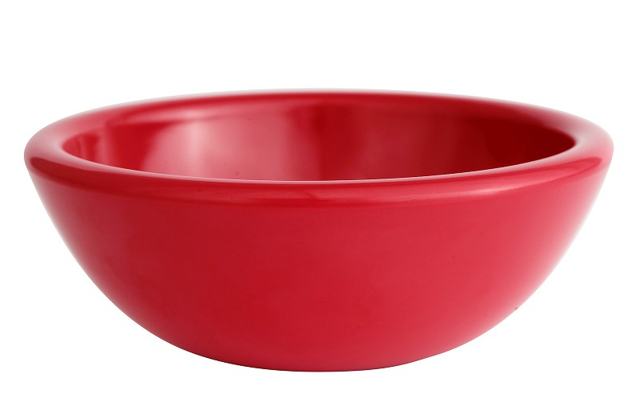
a bowl

Slide 8
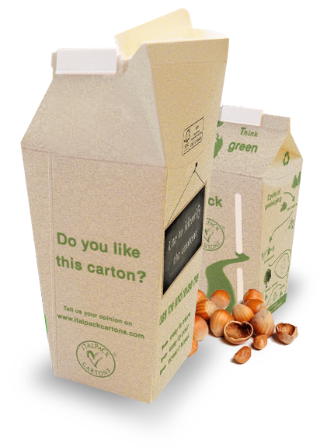
a carton

Slide 9
a packet

Slide 10
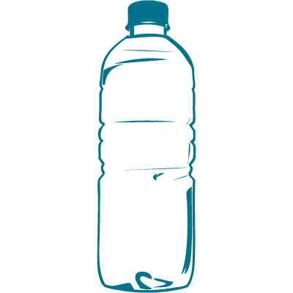
a bottle

